Slide 1


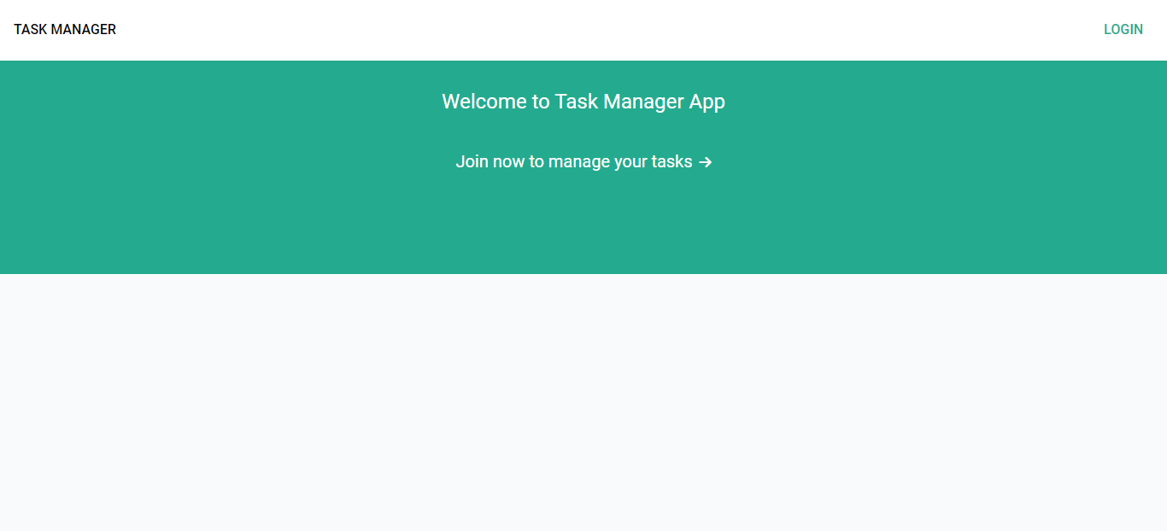
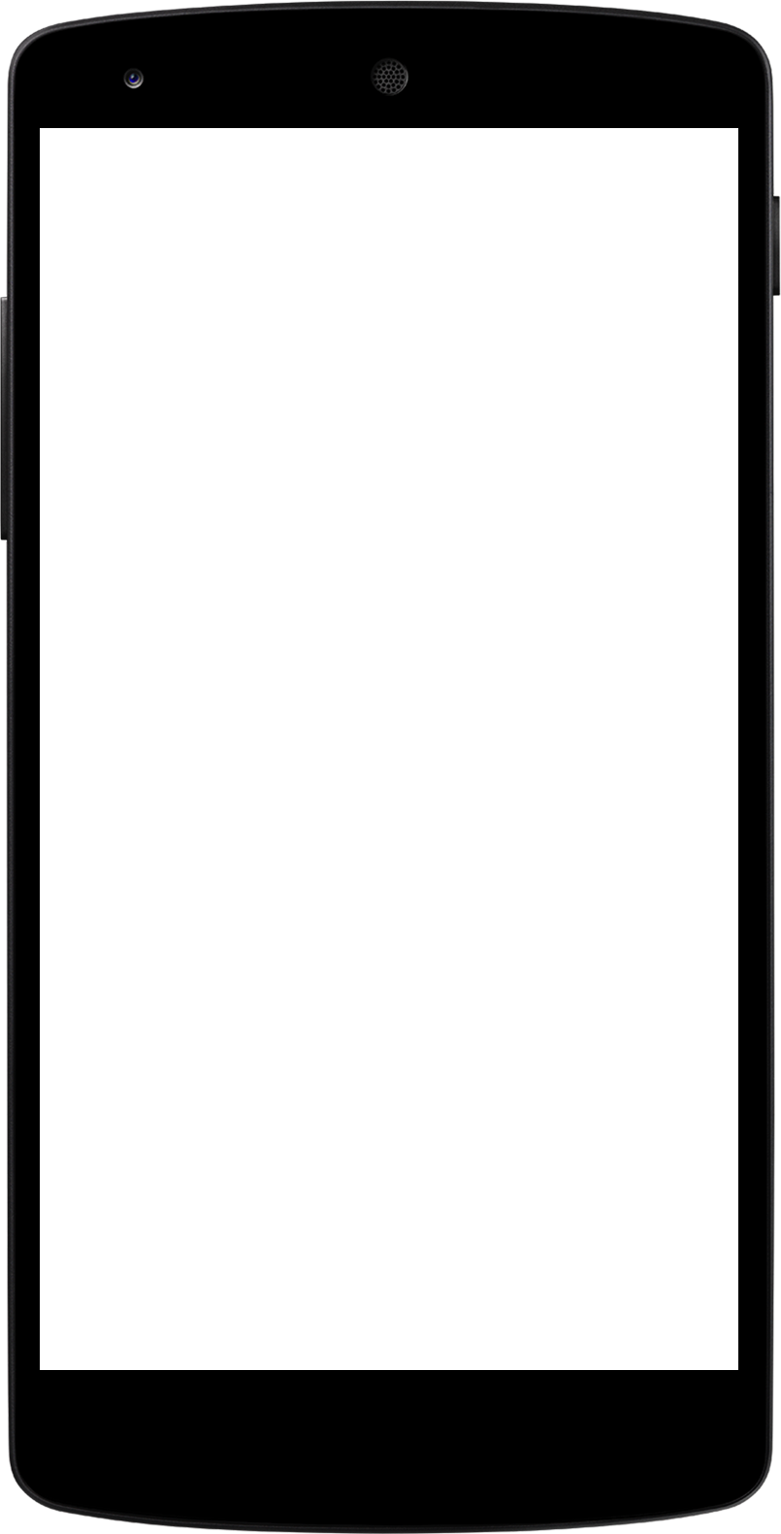
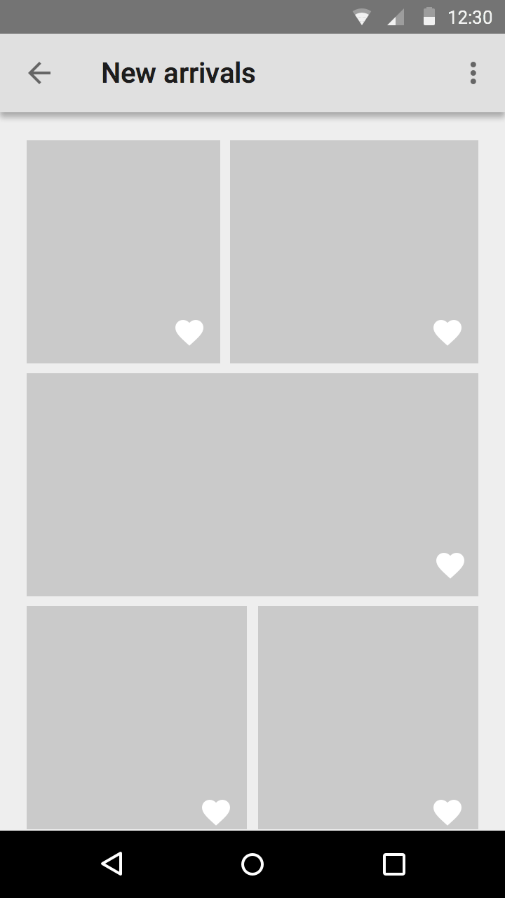
TASK MANAGER APP
MERN STACK APP BY
EGBUNA CELIA

Slide 2
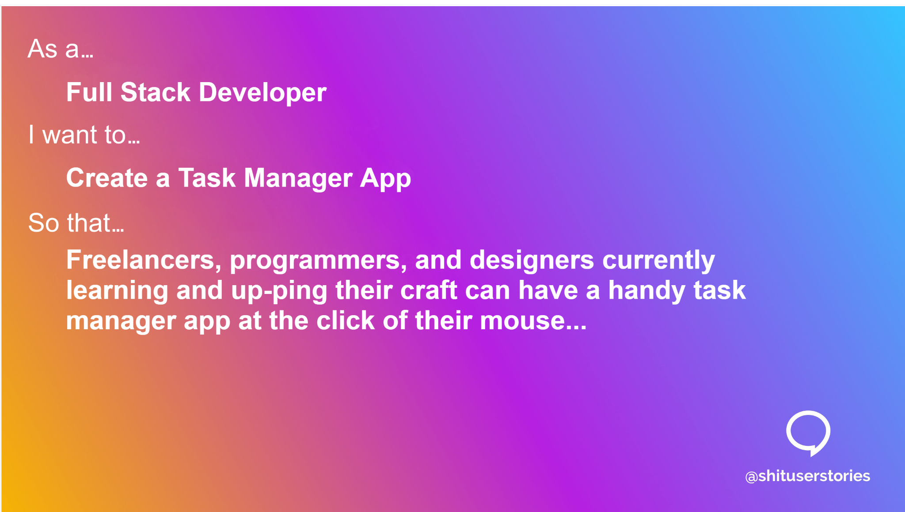

Slide 3
Skills & Expertise
FRONT-END
User experience
BACK-END
DATABASE
USER EXPERIENCE

Slide 4
MERN Task Manager
This is a full-stack task management application made using the MERN stack (MongoDB, Express, React, and Node.js), specially designed for freelancers, developers, and designers, but it can be used by any other professional or business person. With this application, you can set goals to track what you're working towards. You can even break down your goals into smaller targets to make them more achievable. Jump right off the Live App and start managing your tasks, or download the entire source code and run it on your server.

Slide 5
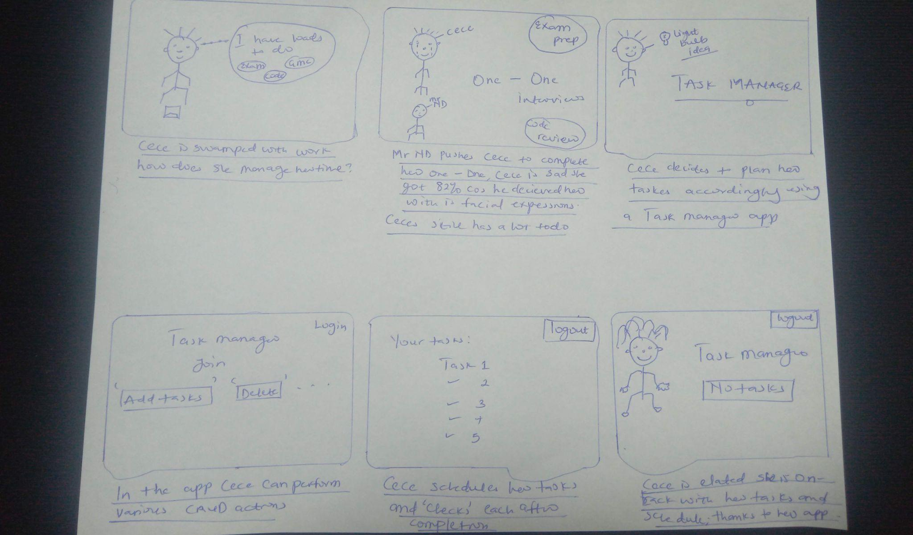
Design Storyboard: scenario: An app to help users manage tasks.

Slide 6
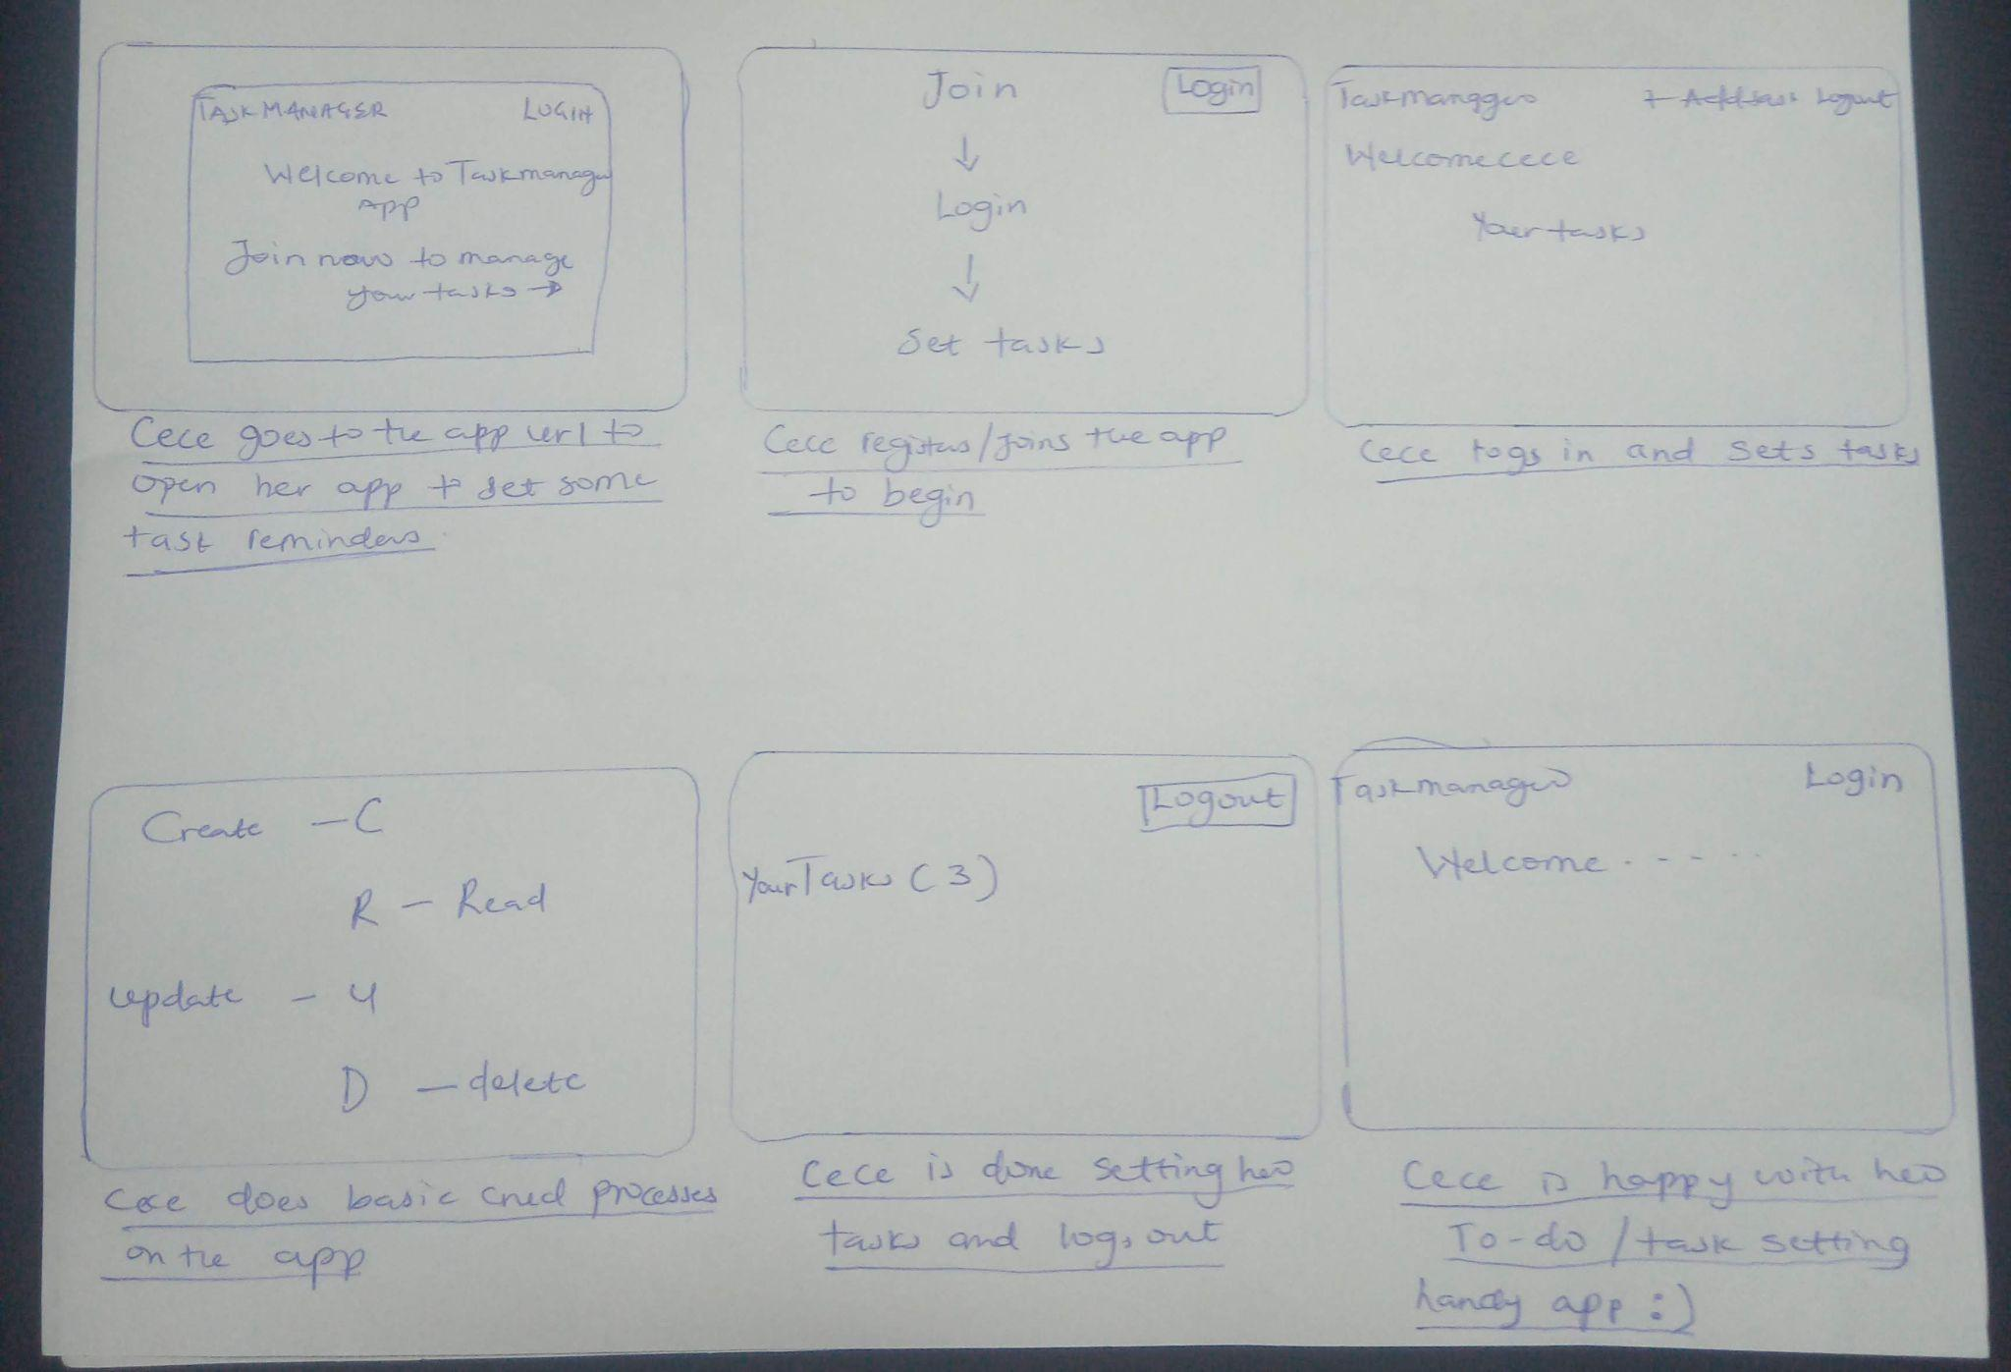
Design Storyboard: Scenario: An app to help users manage tasks.

Slide 7
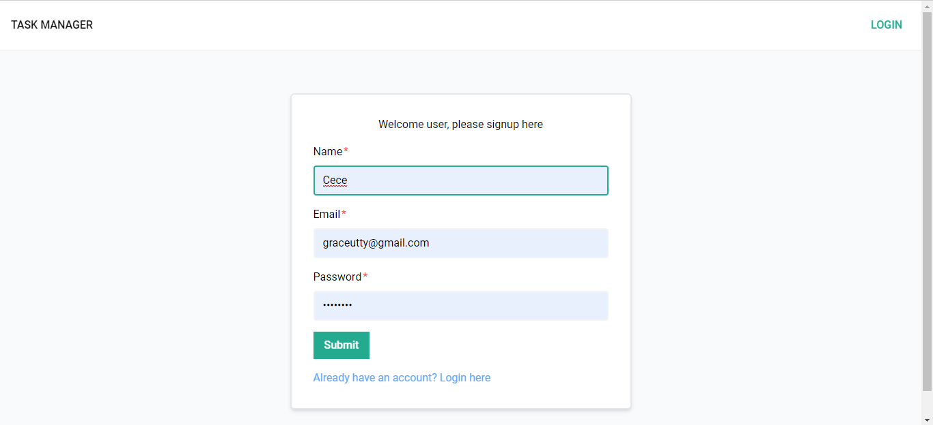
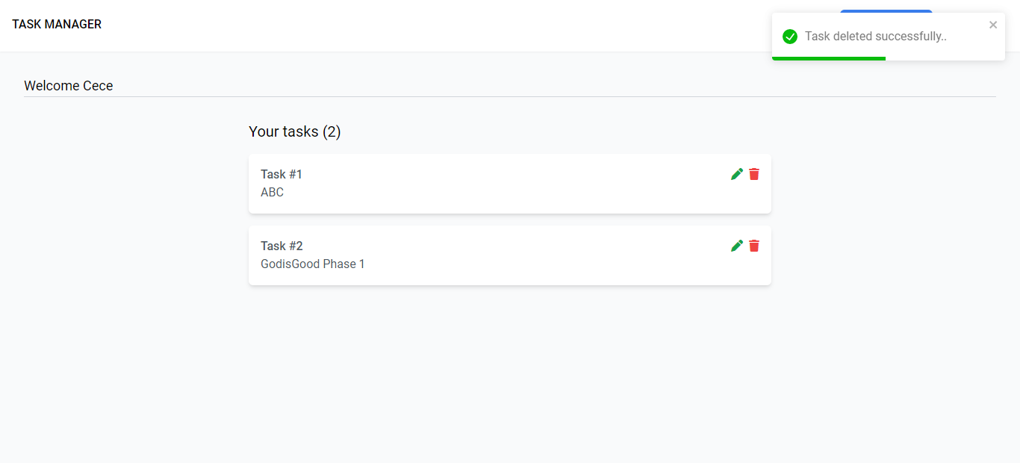
Acme Design Award recipient
Parker Music campaign
Features
User-side features
Signup
Login
Logout
Add tasks
View tasks
Update tasks
Delete tasks

Slide 8

Developer-side features
Toasts for success and error messages
Form validations in frontend and backend
Fully Responsive Navbar
Token based Authentication
Use of 404 page for wrong urls
Relevant redirects
Global user state using Redux
Custom Loaders
Use of layout component for pages
Use of theme colors
No external CSS files needed (made using Tailwind CSS)
Usage of Tooltips
Dynamic document titles
Redirect to previous page after login
Use of various React hooks
Custom hook also used (useFetch)
Routes protection
Middleware for verifying the user in backend
Use of different HTTP status codes for sending responses
Standard practices followed
Source: www.linkedin.com

Slide 9
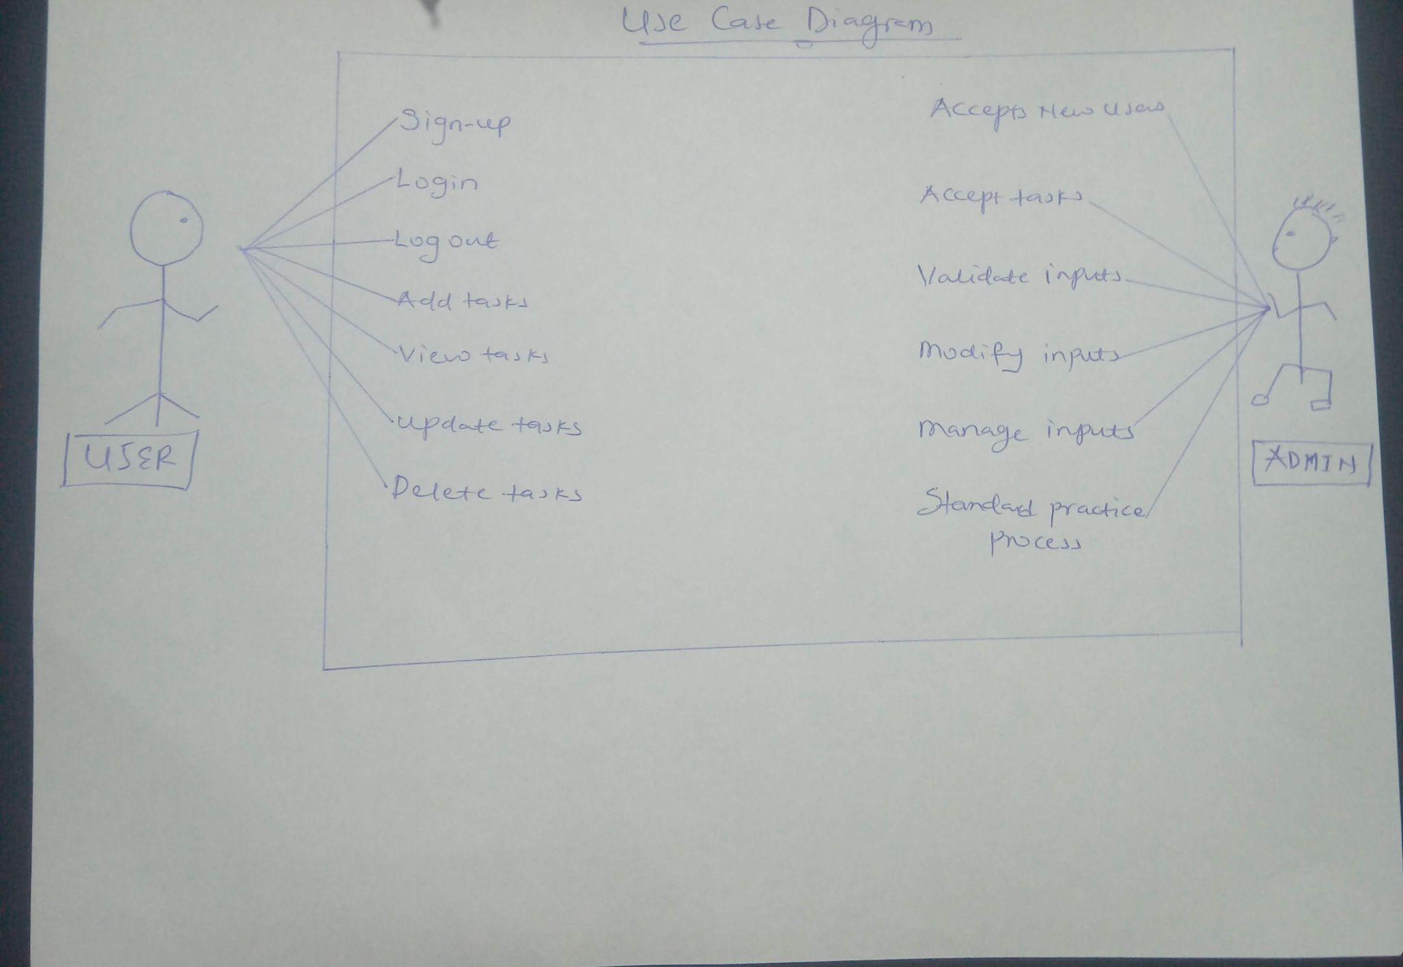
USE CASE DIAGRAM: TASK MANAGER APP.

Slide 10
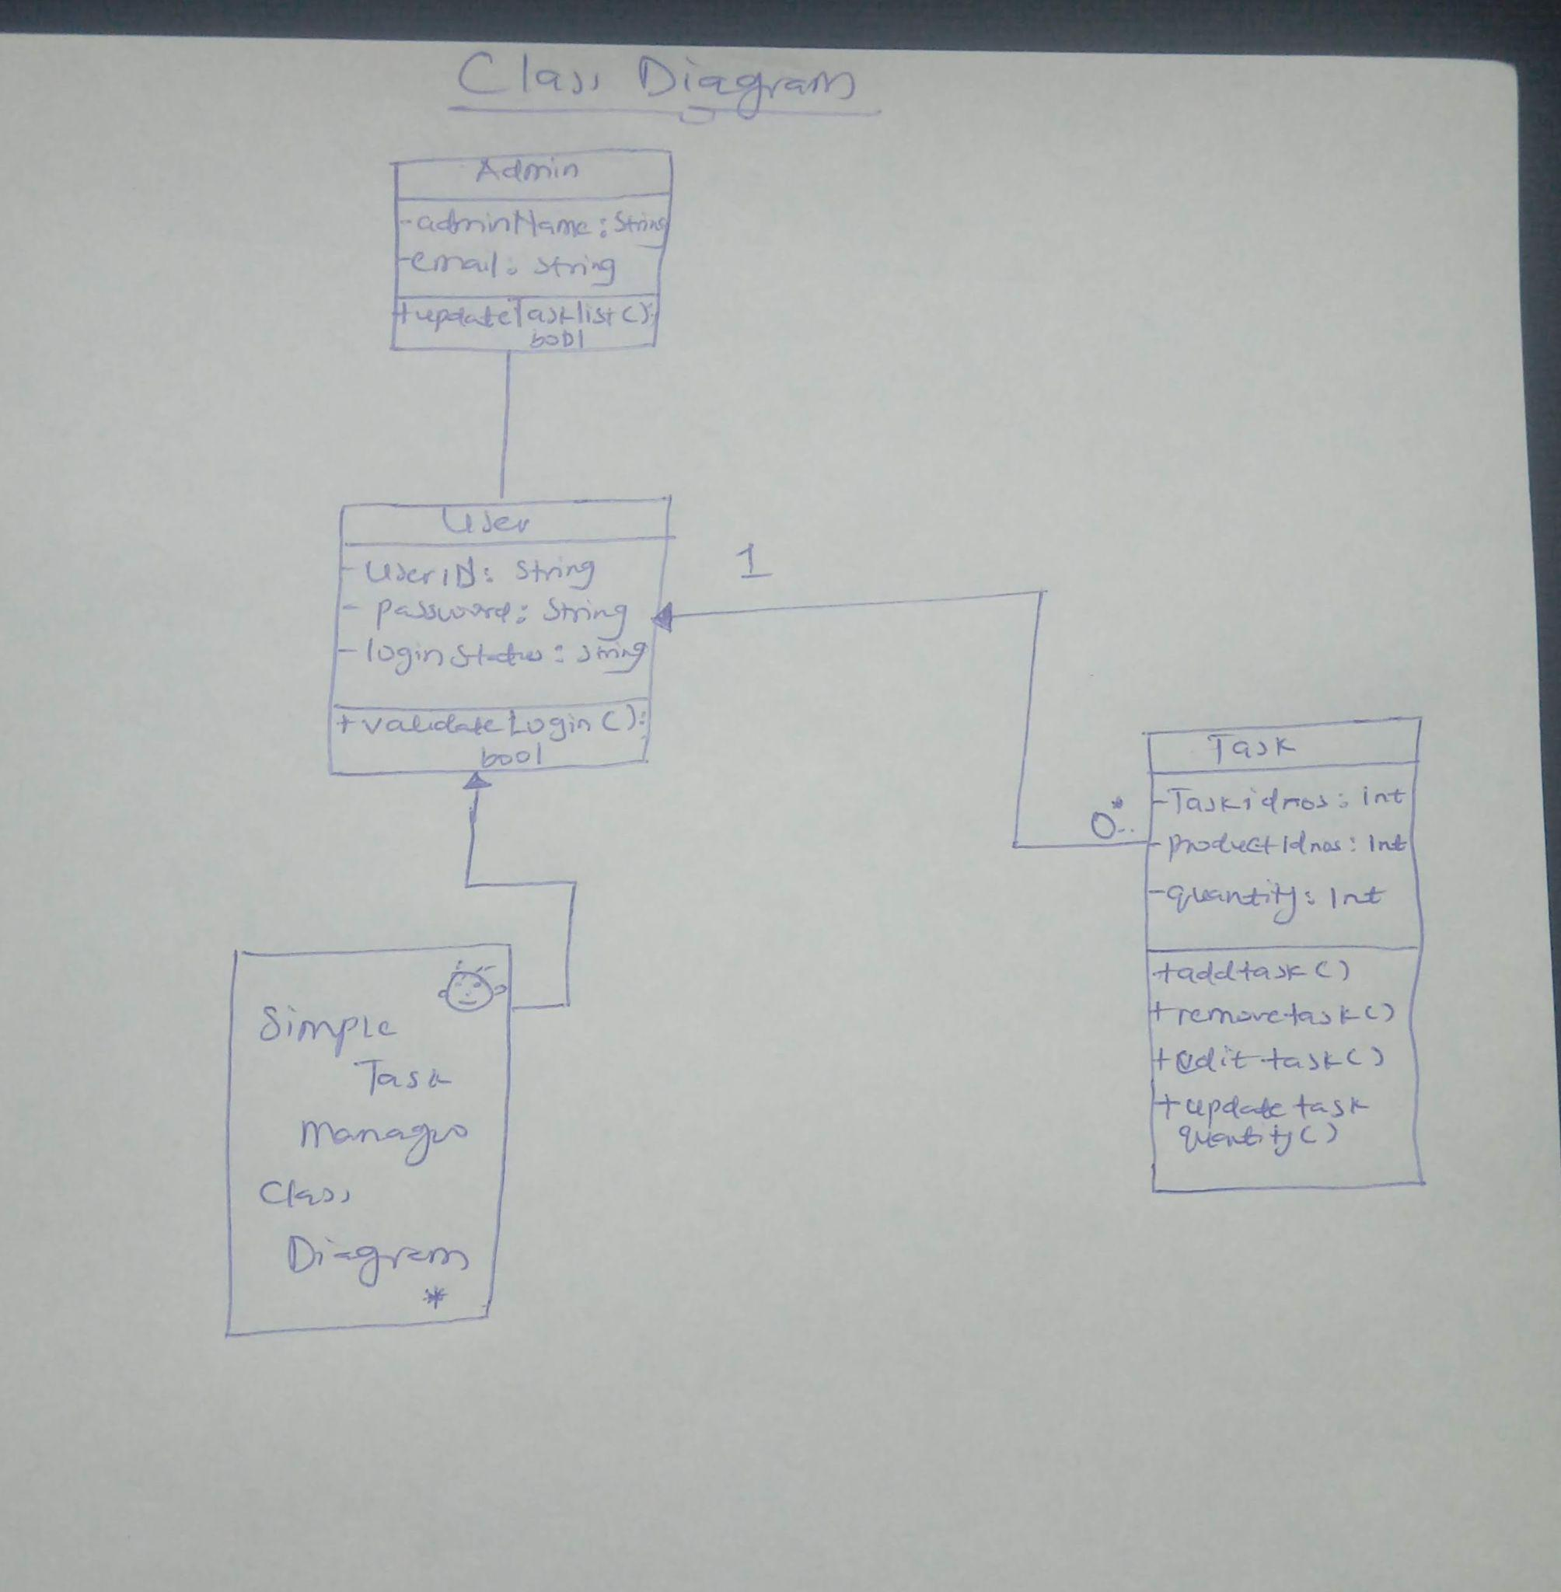
SIMPLE CLASS DIAGRAM: TASK MANAGER APP.

Slide 11
Tools and Technologies
HTML
CSS
Javascript
Tailwind CSS
Node.js
Express.js
React
Redux
Mongodb
Source: www.linkedin.com

Slide 12
Dependencies
The following are the major dependencies of the project:
axios
react
react-dom
react-redux
react-router-dom
react-toastify
redux
redux-thunk
bcrypt
cors
dotenv
express
jsonwebtoken
mongoose
Source: www.linkedin.com

Slide 13
Dev-Dependencies
The following are the major dev-dependencies of the project:
nodemon
concurrently
Prerequisites
Node.js must be installed on the system.
You should have a MongoDB database.
You should have a code editor (preferred: VS Code)
Source: www.linkedin.com

Slide 14
I intend to keep adding more features to this application, so if you like it, please drop me a review. That will encourage me to keep improving the project, and I would love to hear from you. HAPPY TASKIN” :)
Author
Twitter: @Cece-Geekisnewkool
Github: @Cece-Geekisnewkool

